Slide 1
DLHLP - HW4-1
BERT
TA: 紀伯翰，謝濬丞

Slide 2
Task(s)
Natural Language Inference Task(s) - (1)
XNLI-zh dataset
“bert-base-chinese” Model on Github
Contextualization Issue - (2)
Anisotropy
Self-similarity
Intra-sentence similarity
Maximum explainable variance
Chinese Word Segmentation - (3)
Ctb cws Dataset
“bert-base-chinese” Model on Huggingface

Slide 3
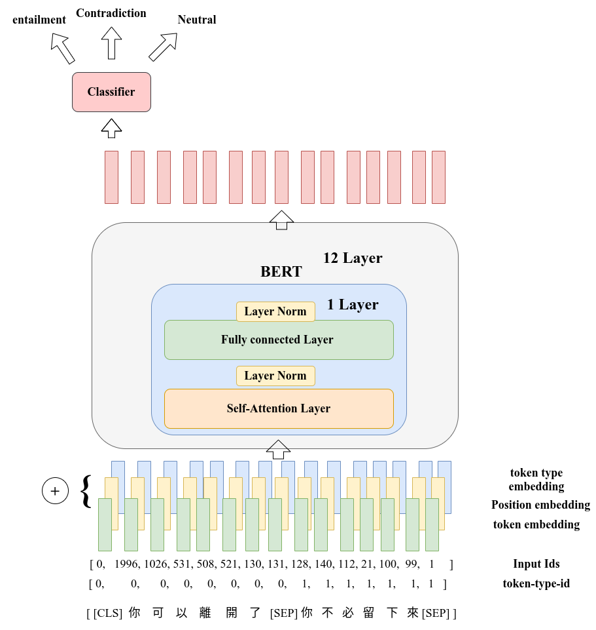

BERT - NLI
Text Entailment
Ground Truth: Entailment
Homework Task

Slide 4
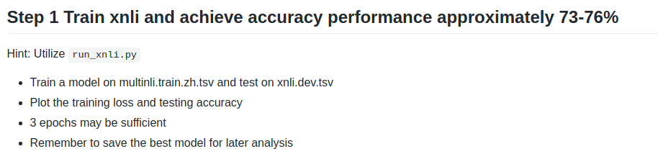
4-1-1 (5%) Natural Language Inference - (1)
Finetune “bert-base-chinese” Model
on XNLI-zh dataset achieve 73 - 76 % performance
Save Model.

Slide 5
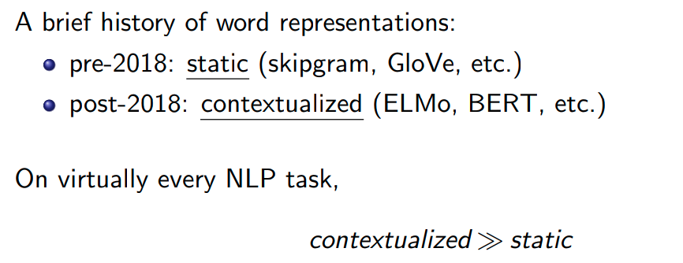
Contextualized v.s static
圖片來源:
EMNLP2019

Slide 6
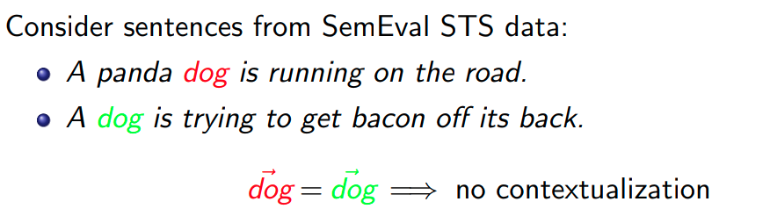
Example - (1)
圖片來源:
EMNLP2019

Slide 7
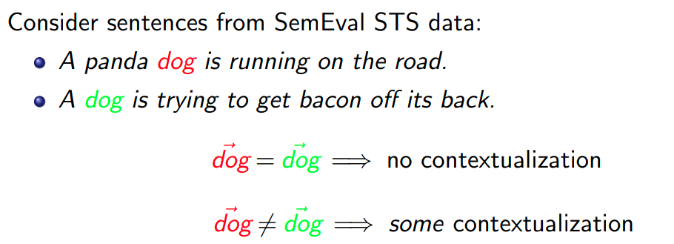
Example - (2)
圖片來源:
EMNLP2019

Slide 8
How to measure the Contextuality ?
Self-similarity
Intra-sentence similarity
Maximum explainable variance
Anisotropy

Slide 9
4-1-2 Definition(s)
Self-similarity
Intra-sentence similarity
Maximum explainable variance
Anisotropy

Slide 10
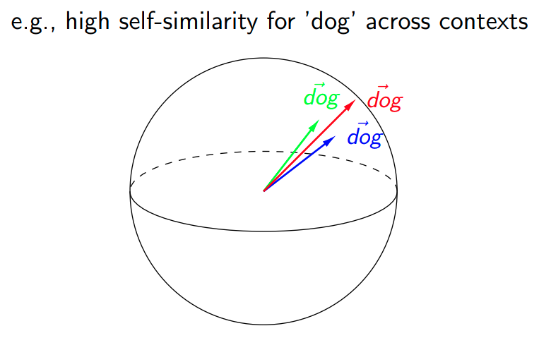
Self-similarity
Average cosine similarity of a word with itself across all contexts, where representations are drawn from the same layer of a given model.
圖片來源:
EMNLP2019

Slide 11
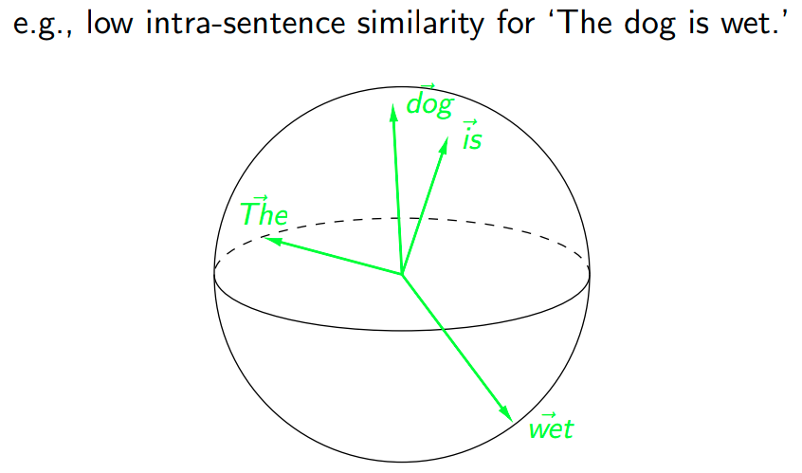
Intra-sentence similarity
Average cosine similarity between a word and its context, where the context is represented as the average of its word representations.
圖片來源:
EMNLP2019

Slide 12
If more Contextualized on vector space,
Expect:
Lower self-similarity
Larger intra-sentence similarity => More Context-specific
Lower maximum explainable variance

Slide 13
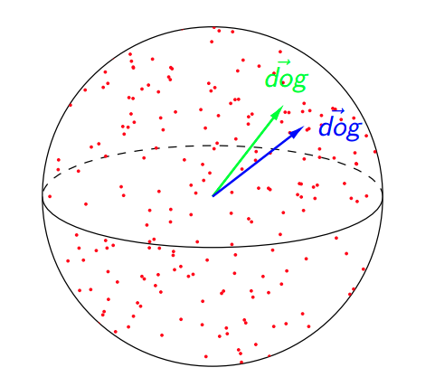
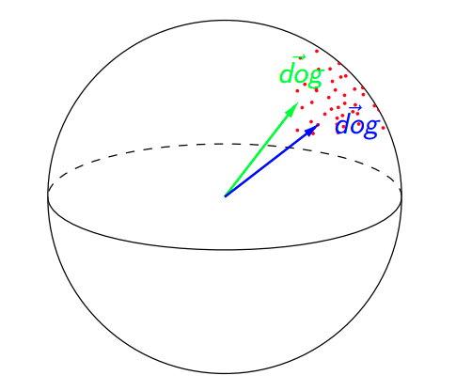
Issue ?
圖片來源:
EMNLP2019

Slide 14
Isotropy vs Anisotropy
圖片來源:
EMNLP2019

Slide 15
Isotropy vs Anisotropy
Self-Similarity(w) = 0.95 is relatively high if all embeddings are isotropic.
Self-Similarity(w) = 0.95 is relatively high if all embeddings are isotropic but relatively low if they are anisotropic.

Slide 16
Prepare Data
Pre-trained Embedding vector
Use “bert-base-chinese” model
extract embedding vector of each word on each layer.
Fine-tuned Embedding vector
Use “saved model” model
extract embedding vector of each word on each layer.

Slide 17
Warning
在接下來，我們要畫的圖裡面，會畫出 BERT 內 從 第 0 層 到 第 12 層的 intra-sentence similarity 以及 anisotropy 還有 self-similarity 這三個 數值， 要注意的一點是 所謂的 第0層 指的就是 前面 BERT 圖示的 token embedding 的 vector，並沒有加上 positional embedding 以及 segment embedding (token type embedding)，如果你是使用助教這份github的話，我在 這份 github的 transformers/model_bert.py 內已有做修改，在第0層的時候是會吐出embedding matrix那一層的embedding，line 375，但你如果是自己做的話，記得要去修正這一點。

Slide 18
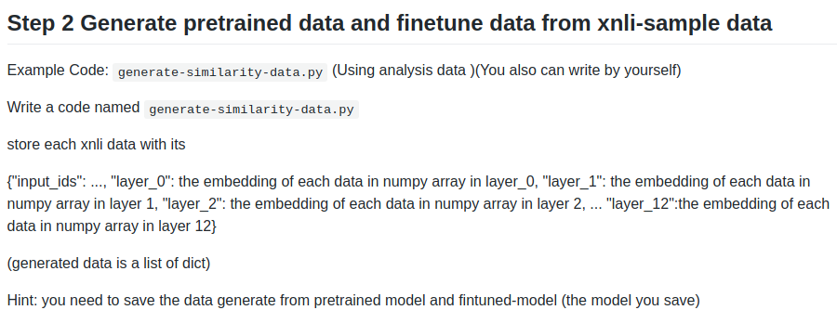
4-1-2 Extract each layer Embedding(s) - (2)

Slide 19
Anisotropy
隨機sample出1000個隨機 word pair，各自算出它們的similarity 並取平均
(每一層都要) 作為那一層的 anisotropy.

Slide 20
Implementation
Hint: similarity_student.py - finish todo block!

Slide 21
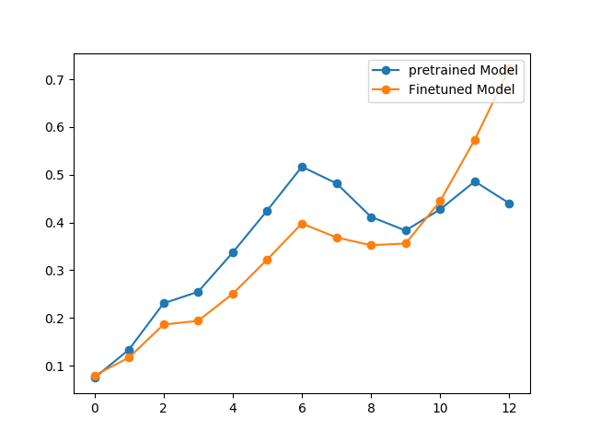
(5%) Implementation -Anisotropy
Plot the Anisotropy:
Self-similarity, Intra-sentence similarity(Anisotropy)

Slide 22
Self-similarity
每一層 對同一個 word 不同 context 兩兩做 cosine-similarity，並取平均
即為 該層的 self-similarity

Slide 23
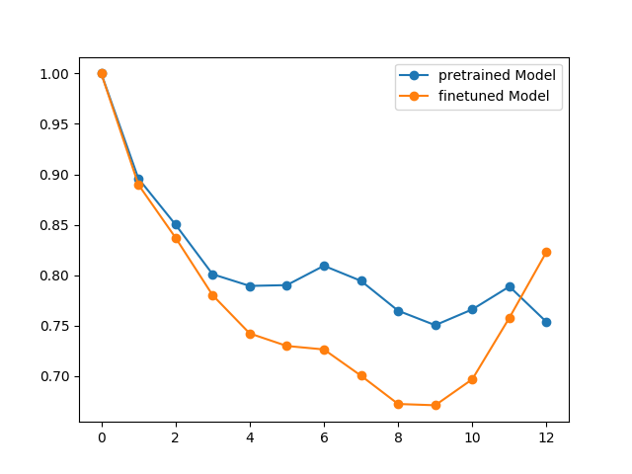
(5%)
Implementation - Self Similarity

Slide 24
Intra-sentence similarity
每一層，同一個句子，把句子內的字的embedding 取平均，即為該句子的 sentence embedding，並把句子內的每一個字對這句話的sentence embedding算cosine similarity ，再取平均即為一筆 intra-sentence similarity，算出所有句子的 intra-sentence similarity 再取平均，即為該層的 intra-sentence similarity.

Slide 25
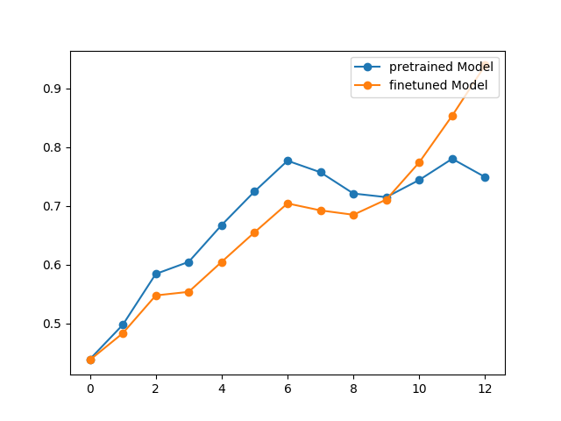
(5%)
Implementation - Intra sentence similarity

Slide 26
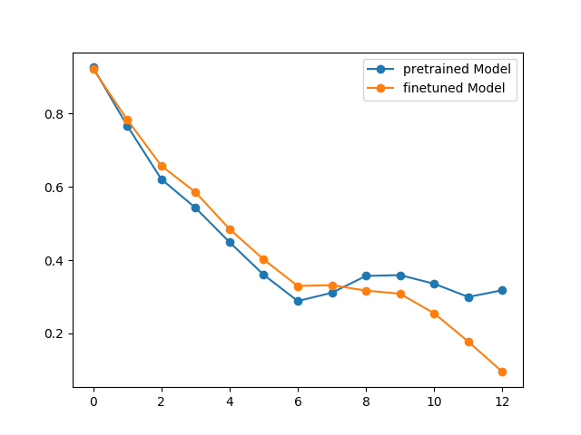
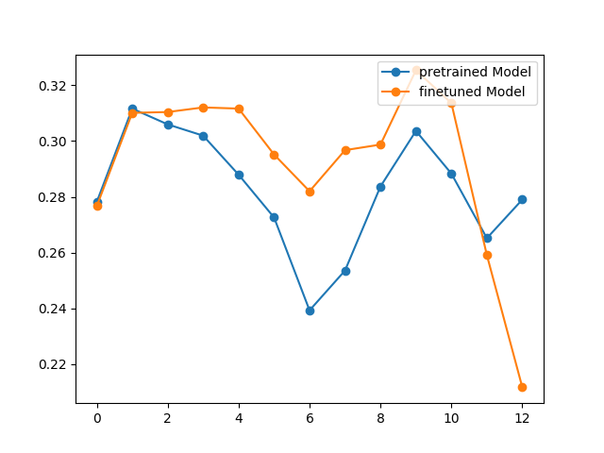
(10%) Adjusting for Anisotropy
Adjust Version:
Self-similarity
Intra-sentence similarity

Slide 27
Bonus: Maximum explainable variance (MEV)
The variance explained by the first principal component of a word’s representations across different contexts.

Slide 28
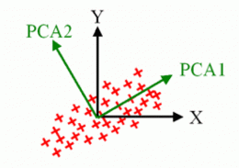
PCA (Principal Component Analysis)
Ref: PCA , SVD
做SVD分解所對應到的最大 singular value
(singular value)^2 / 所有singular value平方和
即為 MEV 的值
參考: paper equation (3).

Slide 29
Chinese Characters & Words
Characters: 漢字，中文的基本組成單位。e.g. 揶、揄...
Words: 詞彙，中文裡表達意思的最小單位。e.g. 家、國、鍋、揶揄...

Slide 30
Chinese Word Segmentation (CWS)
我一直是在親自指揮，親自部署。
我 一直 是 在 親自 指揮 ， 親自 部署 。

Slide 31
Task
Transformer models always take Chinese characters but words as inputs
Does a pretrained Chinese language model know what a Chinese word is?
Can we make the claim that a pretrained Chinese language can do CWS if it has learnt Chinese words during pretraining?
In this part, we formulate CWS as a Sequence Labeling task

Slide 32

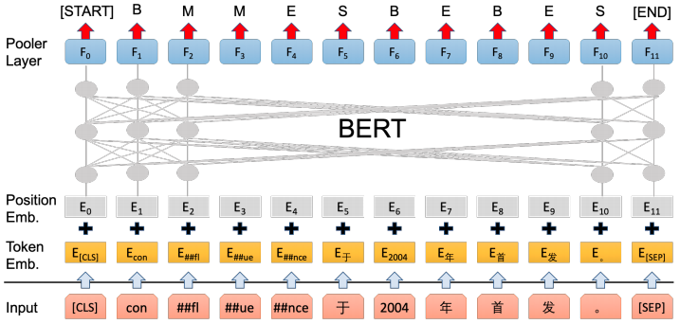
As a sequence labeling task
Bert Meets Chinese Word Segmentation

Slide 33
Prepare data
Training & Dev data: https://github.com/Sologa/CWS_dlhlp
Modify modeling_bert.py and utils_ner.py on Huggingface
The labels are [‘B’, ‘M’, ‘E’, ‘S’]
Note that the labels of a sequence are required to appear in some certain order. You may need to decode your result with Viterbi algorithm if it is not a valid sequence label
For Viterbi algorithm or CRF, refer to Sequence Labeling tutorial
Notes:
viterbi的decoding可以參考tutorial的model.py以及inference.py

Slide 34
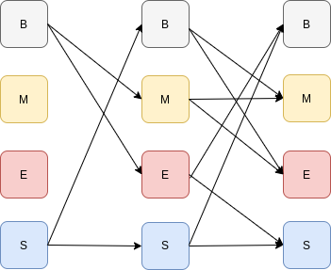
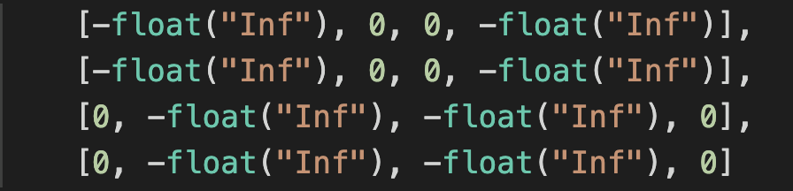
Transition Diagram
B, M, E, S,
B
ME
S

Slide 35
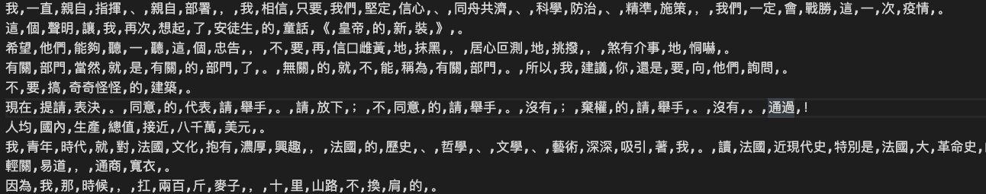
Github submission
Restricted to Python version 3.6.8 and you cannot import additional packages in modeling_bert.py and utils_ner.py
We will test your code by example.py
Submit the following files to YOUR_REPO/hw4/cws
modeling_bert.py
utils_ner.py
config.json (the config file in the same directory as your finetuned model)
download_model.sh for downloading your finetuned model which must be named my_cws_bert.pt (originally named pytorch_model.bin). It will be executed by bash download_model.sh
segmented.csv for results of the segmented sentences (1. of part2 in report) with words separated by commas
Notes:
為了方便起見，training的時候可以使用huggingface repo裡的example/ner/ 的run_ner.py及utils_ner.py，然後把src/transformers/ 拉到跟上述兩個檔案同一個dir。
YOUR_DIR/{run_ner.py, utils_ner.py, transformers} , 其中modeling_bert包含在 transformers/ 裡面

Slide 36
Report
report 連結 請一併放到 YOUR_REPO/hw4 命名為 report.pdf 一併繳交

Slide 37
Deadline
2020.5.27 9:00

